Slide 1
Managerial Economics Basic
Definition of economics
Economics is a social science that focuses on the production, distribution, and consumption of goods and services. The study of economics is primarily concerned with analysing the choices that individuals, businesses, governments, and nations make to allocate limited resources.
Micro and Macro Economics
Microeconomics is the field of economics that looks at the economic behaviours of individuals, households, and companies. Macroeconomics takes a wider view and looks at the economies on a much larger scale—regional, national, continental, or even global.
Industrial revolution
Industrial Revolution, in modern history, the process of change from an agricultural and handicraft economy to one dominated by industry and machine manufacturing. These technological changes introduced novel ways of working and living and fundamentally transformed society. This process began in Britain in the 18th century and from there spread to other parts of the world. Although used earlier by French writers, the term Industrial Revolution was first popularized by the English economic historian Arnold Toynbee (1852–83) to describe Britain’s economic development from 1760 to 1840. Since Toynbee’s time the term has been more broadly applied as a process of economic transformation than as a period of time in a particular setting. This explains why some areas, such as China and India did not begin their first industrial revolutions until the 20th century, while others, such as the United States and western Europe, began undergoing “second” industrial revolutions by the late 19th century.

Slide 2
Information Revolution
America has entered into what's been called the Information Revolution, which has been centred around the creation and proliferation of the Internet and has made it easier than ever for businesses around the world to share knowledge, leading to a significant global economic impact. Technology has allowed production to no longer be slowed by oceans or mountains, and the speed with which ideas and money can travel is nearly instantaneous. Because of information revolution advancements, information can now be transmitted in real time, meaning that there are no delays in worldwide distribution. As events unfold across the planet, people everywhere can have instant access to this information and thus adapt in various ways. As diseases spread and cures are discovered, the global community can be better prepared to help people faster than ever before. Researchers in any field and in any country can share ideas and designs on projects together in real time, or in other words, instantaneously. This rapid exchange of information can lead to big changes in the global economy, as companies buy and sell products and services in real-time response to world events.

Slide 3
Technological change in a global economy
Technological advancements have been shaping the global economy in significant ways, from the way we communicate, do business and access information. From the internet and the rise of e-commerce to automation and artificial intelligence, technology is driving economic growth and changing the way we live and work. In this article, we will explore how technological advancements are shaping the global economy.
One of the most significant ways that technology is shaping the global economy is through the rise of e-commerce and online marketplaces. The internet has made it possible for businesses of all sizes to reach customers all over the world, creating new opportunities for entrepreneurs and small businesses. Additionally, online marketplaces such as Amazon and Alibaba have disrupted traditional brick-and-mortar retail, leading to significant changes in the way goods are produced, distributed and consumed.
Another way that technology is shaping the global economy is through automation and the increased use of artificial intelligence (AI). Automation and AI are making many tasks and processes faster, more efficient, and more accurate, but they are also having a significant impact on jobs and industries. Automation is replacing human workers in many tasks and creating new opportunities, but also leading to job loss and income inequality. Furthermore, with the integration of AI in various sectors, it is leading to increased productivity, improved decision-making, and cost reduction for businesses.
Technology is also having a significant impact on the way we communicate, access information and collaborate. From social media to instant messaging and cloud computing, technology is enabling faster, more efficient and more cost-effective communication and information sharing. This is fostering an environment of collaboration, innovation and cross-border business partnerships and opportunities.

Slide 4
messaging and cloud computing, technology is enabling faster, more efficient and more cost-effective communication and information sharing. This is fostering an environment of collaboration, innovation and cross-border business partnerships and opportunities.
Additionally, technology is also driving economic growth through innovation and the development of new products and services. The rise of the sharing economy, digital platforms, and the internet of things (IoT) are examples of how technology is driving innovation and creating new business models and revenue streams.
However, it's important to note that technology can also have a negative impact on the economy. Unequal access to technology can exacerbate income inequality, and the rapid pace of technological change can make it difficult for workers and businesses to adapt, leading to job displacement and economic hardship. To mitigate these negative effects, governments, businesses, and individuals need to invest in education and training to create a workforce that can adapt to these changes.
In conclusion, technological advancements are shaping the global economy in significant ways, from the way we communicate, do business, and access information. They are driving economic growth, creating new opportunities, and fostering innovation, but also challenging traditional business models and leading to job displacement. Governments, businesses, and individuals must work together to address the challenges and opportunities presented by technology in order to ensure that the benefits of technological progress are shared broadly and equitably.

Slide 5
Additionally, technology is also driving economic growth through innovation and the development of new products and services. The rise of the sharing economy, digital platforms, and the internet of things (IoT) are examples of how technology is driving innovation and creating new business models and revenue streams.
However, it's important to note that technology can also have a negative impact on the economy. Unequal access to technology can exacerbate income inequality, and the rapid pace of technological change can make it difficult for workers and businesses to adapt, leading to job displacement and economic hardship. To mitigate these negative effects, governments, businesses, and individuals need to invest in education and training to create a workforce that can adapt to these changes.
In conclusion, technological advancements are shaping the global economy in significant ways, from the way we communicate, do business, and access information. They are driving economic growth, creating new opportunities, and fostering innovation, but also challenging traditional business models and leading to job displacement. Governments, businesses, and individuals must work together to address the challenges and opportunities presented by technology in order to ensure that the benefits of technological progress are shared broadly and equitably.

Slide 6
Market Failure
What is market failure?
This is when the market system does not allocate resources as efficiently as possible.It has been observed that a private market, if left up to its own mechanisms will not achieve efficiency
Economic efficiency This occurs when resources are used in such a way that allocative and productive efficiency are achieved. This means goods are being produced at the lowest possible cost, etc.Productive efficiency means that we are using resources in such a way that is impossible to increase the production of one good without reducing the production of another good.Allocative efficiency means that resources are allocated in such a way that it is impossible to make someone better off without making another person worse-off.

Slide 7
Causes of Market Failure MonopolyMerit and Public goodsExternalities (Positive and Negative)
1. Monopoly
A monopoly is productively inefficient because is produces less output than what is demanded by society. Therefore, producer’s surplus and consumer’s surplus are not maximized.
Consumers’ Surplus-
this is when the value consumers place on a product is higher than the market price. This means consumers are willing to pay more for the product than what it is being sold for. Monopolists will sell their product at almost the same price the consumers would buy it for and so take away this bonus.Producers’ Surplus- this is when the market value (price) of a product is way above the cost of producing it. This means the producers gets extra profits. Monopolists do not enjoy producers’ surplus because they are too cost inefficient.

Slide 8
Merit and Public goods Merit goods-
These are goods that benefit the welfare of society, for example, education and healthcare. The production of these goods is not profitable and therefore private individuals will not produce as much as is needed by society. This causes market failure as the good is under-produced and so enough is not available to consumers. The government may intervene by subsidizing or producing it themselves.
Public goods-
These are goods which when produced can be used by everyone in society. E.g. street lights. The two main characteristics are: A. non-rivalry – no one needs to compete to use these goods as they are always available. B. non- excludable – you cannot stop any one from using it once it has been produced. For example: sidewalks and public beaches.Since you cannot stop anyone from using these products it would be impossible for the entrepreneur to make profits and so businesses will not produce these goods. Why pay for something they cannot stop you from using? The market fails to produce these goods that are very essential to social welfare.

Slide 9
. Externalities
The production of goods will carry either positive or negative effects on other people. These are not take into consideration when deciding how much to produce. An externality is a benefit or cost incurred in a business transaction that affects other people not involved in the transaction.
There are two types of externalities: Positive externalities- This is when the benefits society gets from a product are greater than the cost of producing it. For example the benefits of good health are much greater than the cost of healthcare. These goods are usually under-produced. This causes the market to fail because people are not getting as much for the good as they would like. Government could subsidize these goods to increase production.

Slide 10
Negative externalities- This is when the cost to society is greater than the benefits they are receiving. This means the producers are not paying the full cost for producing it. For example the pollution caused by factories is not paid for in its price, this inconvenience has to be borne by society. These goods are usually over-produced. This causes the market to fail because too much of a ‘bad’ good is being produced. Government could tax these goods more to reduce production.
How the government tries to solve market failure Direct provision Taxes and subsidies Regulation and Legislation
Direct provision Direct provision- The government may become involved in the production and distribution of these goods. By: Nationalization- this occurs when the government takes over a private firm. The government will now decide how much to produce, how to produce and for whom to produce. Privatization- this is the opposite of nationalization. This occurs when the government sells a firm to private individuals. Therefore, private individuals will make all the economic decisions.
Taxes and subsidies Taxes are usually used by the government to reduce the production of a particular good and so shift the resources to another industry. For example the government may tax alcoholic beverages to discourage production; these resources could in turn be used to produce sodas. Subsidies are used by government to encourage or increase production of a good. This is in the form of grants, etc. This reduces the cost of production and so the producer is able to reduce its price which will enable consumers to buy more.

Slide 11
Markets for Information Goods
Foundation of information Economy
INFORMATION ECONOMY
Information Particular Facts or something knowledgeable. Anything that can be digitized: encoded as a stream of bits. Eg: text, image, voice, video etc. Information good Anything that is digitized, and also consumers are willing to pay for it Eg: Music, online books, DVD. Movies. Information has value to different consumers. Entertainment value. Business value

Slide 12
FOUNDATIONS OF THE INFORMATION ECONOMY Communication, Technology,
Information Communication requires technology to transmit information.
As that technology progresses, the volume of information communicated can rise New technologies arise at a faster rate when information can be communicated to more people at a cheaper price and more quickly.
The Cost of Producing Information Information is costly to produce but cheap to reproduce.
High fixed costs but low marginal costs.
The cost of producing the first copy may be substantial, but that of producing additional copies is negligible Price information according to its value, not its cost

Slide 13
Managing Intellectual Property Any information entity that is a creation of mind and has a monetary value
Cost is incurred in producing the first copy of that information and hence a suitable price is set to sell it
Creators of information look to overcome cost incurred
Threat
Cheap reproduction and sales by other parties
E.g.. EA Sports FIFA games, the cracked versions can be protected through Copyrights, Patent, and Trademark Acts
When managing Intellectual property, your goal should be To choose the terms and conditions that maximize the value of your intellectual property, Not the terms and conditions that maximize the protection

Slide 14
The Role of Information in an Economy
Transaction costs
Transaction costs are expenses incurred when buying or selling a good or service, outside the cost of the good or service itself. Transaction costs represent the labour required to bring a good or service to market or to connect a buyer with a seller. There are entire industries dedicated to facilitating these types of exchanges.
Transaction costs can include things like brokers' commissions and spreads, which are the differences between the price the dealer pays for a security and the price the buyer pays. Other examples are commissions paid to professionals such as real estate agents.

Slide 15
Information costs
If an investment company needs information on a financial asset, they are about to put to investment the company will require a budget for the information cost. The types of information costs are purchase costs, search costs, communication costs, analysis cost, automation development cost, and travel costs.
All information costs some type of resource(s) to produce (e.g., money, hours, use of equipment).
Economic of search
The economics of search study the implications of resistances for individual behaviour and market performance, due usually to imperfect information about exchange possibilities.

Slide 16
Information problems
Speculation and Risk Bearing
What is Speculation? In the world of finance, speculation, or speculative trading, refers to the act of conducting a financial transaction that has substantial risk of losing value but also holds the expectation of a significant gain or other major value.
Speculative describes very risky and unproven ideas or chances. You might have great ideas about starting your own business but your plans are speculative until you earn money from them. Speculative describes abstract ideas — usually with high risk — that often come with excitement and expectation too. For example- An investor who invests in foreign currency buys some currency in the hopes of selling it at an appreciated rate when market fluctuations happen. This type of speculation is known as currency speculation.

Slide 17
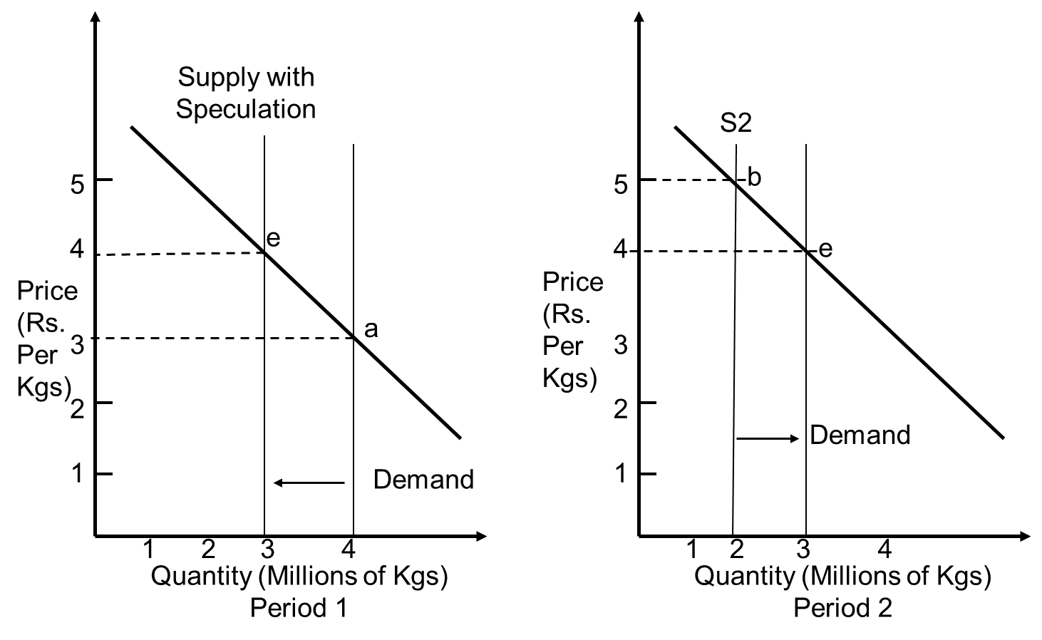
Speculators are sophisticated investors or traders who purchase assets for short periods of time and employ strategies in order to profit from changes in its price.
Speculators are important to markets because they bring liquidity and assume market risk. Conversely, they can also have a negative impact on markets, when their trading actions result in a speculative bubble that drives up an asset's price to unsustainable levels.

Slide 18
Future Market
A futures market is an auction market in which participants buy and sell commodity and futures contracts for delivery on a specified future date. Futures are exchange-traded derivatives contracts that lock in future delivery of a commodity or security at a price set today.
A futures market is an exchange where futures contracts are traded by participants who are interested in buying or selling these derivatives.
In the U.S., futures markets are largely regulated by the Commodity Futures Trading Commission (CFTC), with futures contracts standardized by exchanges.
Today, the majority of trading of futures markets occurs electronically, with examples including the CME and ICE.
Unlike most stock markets, futures markets can trade 24 hours a day

Slide 19
In order to understand fully what a futures market is, it’s important to understand the basics of futures contracts, the assets traded in these markets.
Futures contracts are made in an attempt by producers and suppliers of commodities to avoid market volatility. These producers and suppliers negotiate contracts with an investor who agrees to take on both the risk and reward of a volatile market.
Futures markets or futures exchanges are where these financial products are bought and sold for delivery at some agreed-upon date in the future with a price fixed at the time of the deal. Futures markets are for more than simply agricultural contracts, and now involve the buying, selling and hedging of financial products and future values of interest rates.

Slide 20
For instance, if a coffee farm sells green coffee beans at $4 per pound to a roaster, and the roaster sells that roasted pound at $10 per pound and both are making a profit at that price, they’ll want to keep those costs at a fixed rate. The investor agrees that if the price for coffee goes below a set rate, the investor agrees to pay the difference to the coffee farmer.
If the price of coffee goes higher than a certain price, the investor gets to keep profits. For the roaster, if the price of green coffee goes above an agreed rate, the investor pays the difference and the roaster gets the coffee at a predictable rate. If the price of green coffee is lower than an agreed-upon rate, the roaster pays the same price and the investor gets the profit.

